Slide 1


Titolo presentazione sottotitolo
Supply and demand curves of the electricity spot market
Milano, XX mese 20XX
Group: C. Barbieri – R. Fortuna – F. Galli - L. Grifalconi – A. Howe
Tutor: Guillaume Koechlin – Filippo Bovera

Slide 2
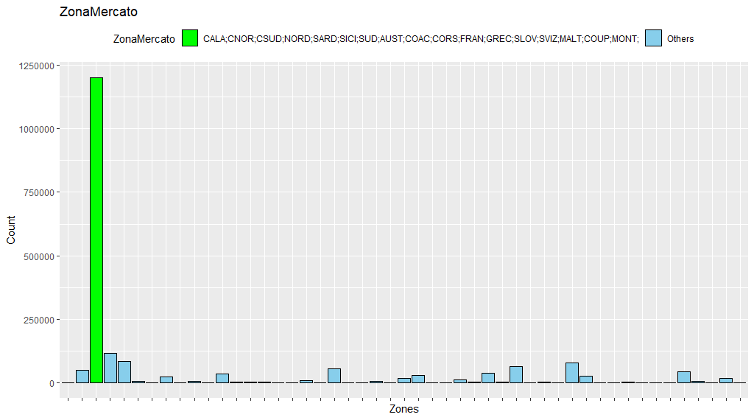
ZonaMercato Values

Slide 3
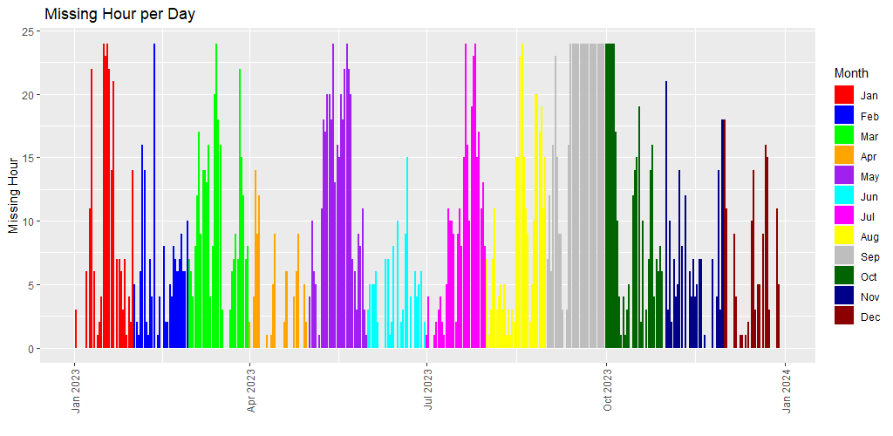
ZonaMercato missing hours

Slide 4
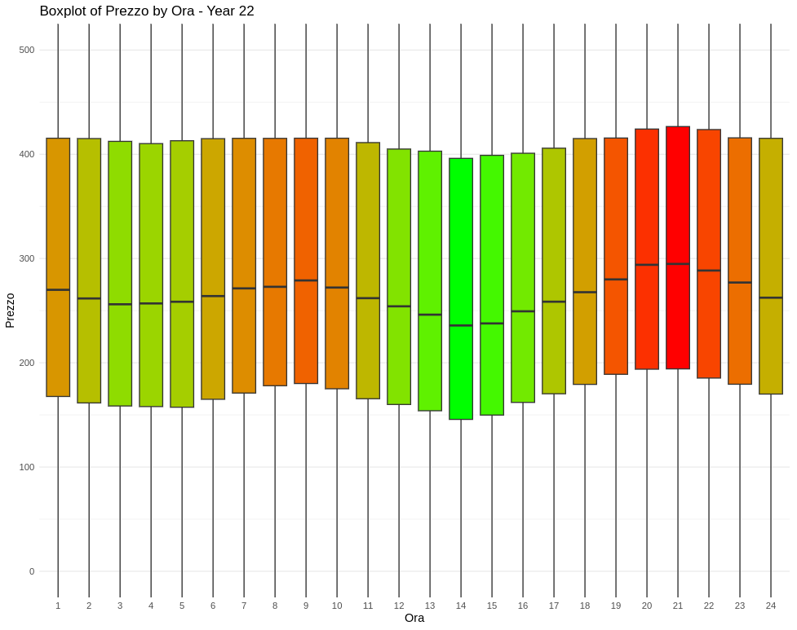
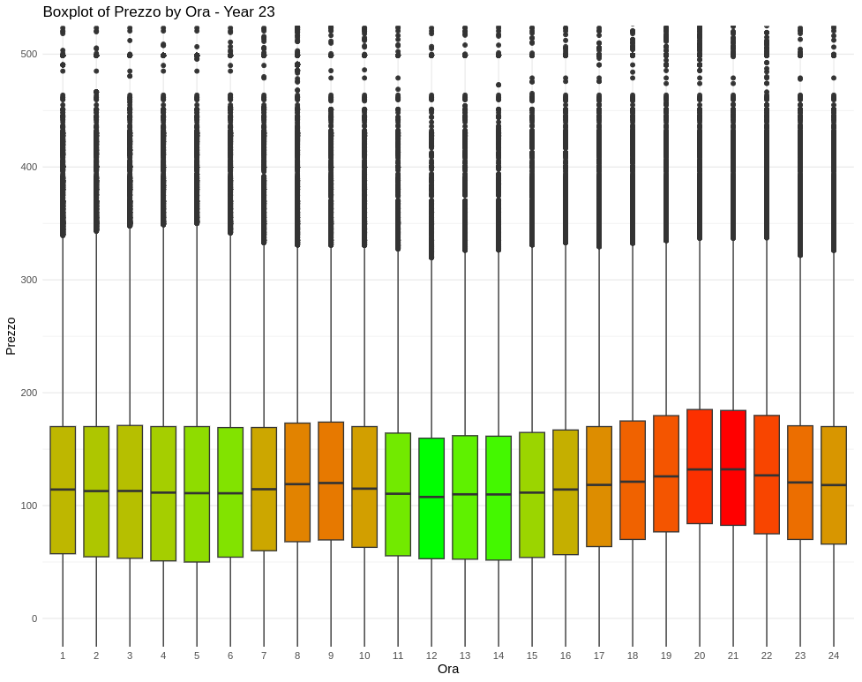
Hourly Price Trend 2022 - 2023

Slide 5
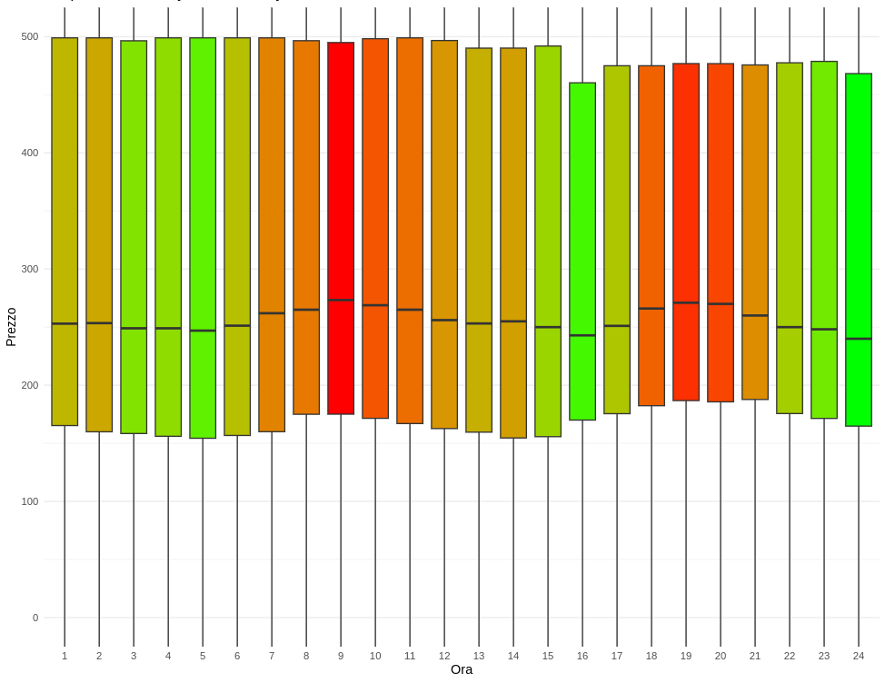
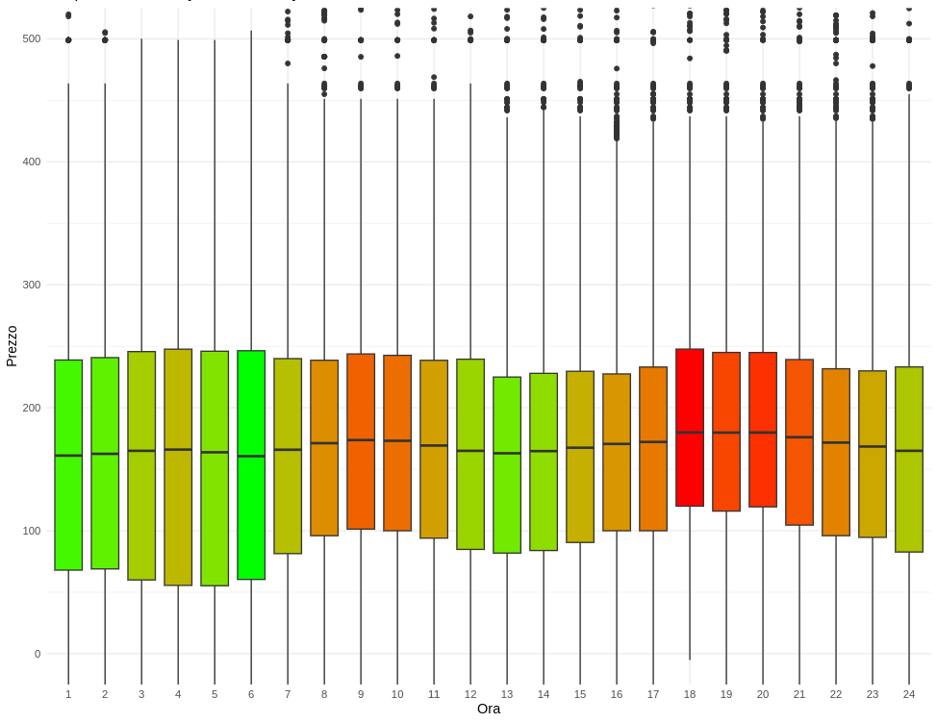
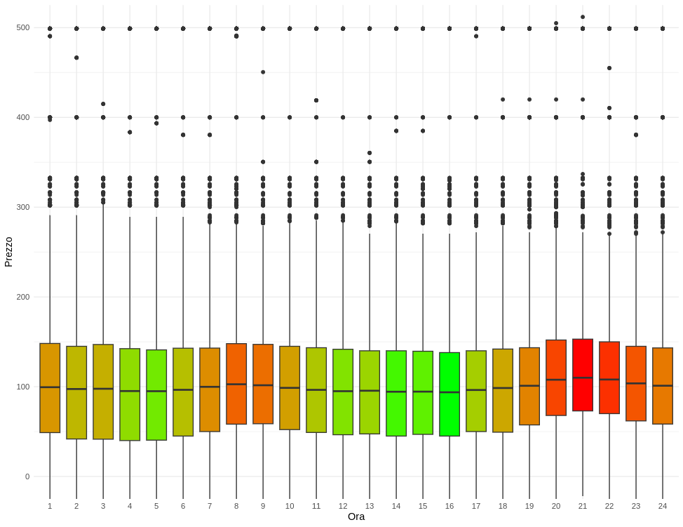
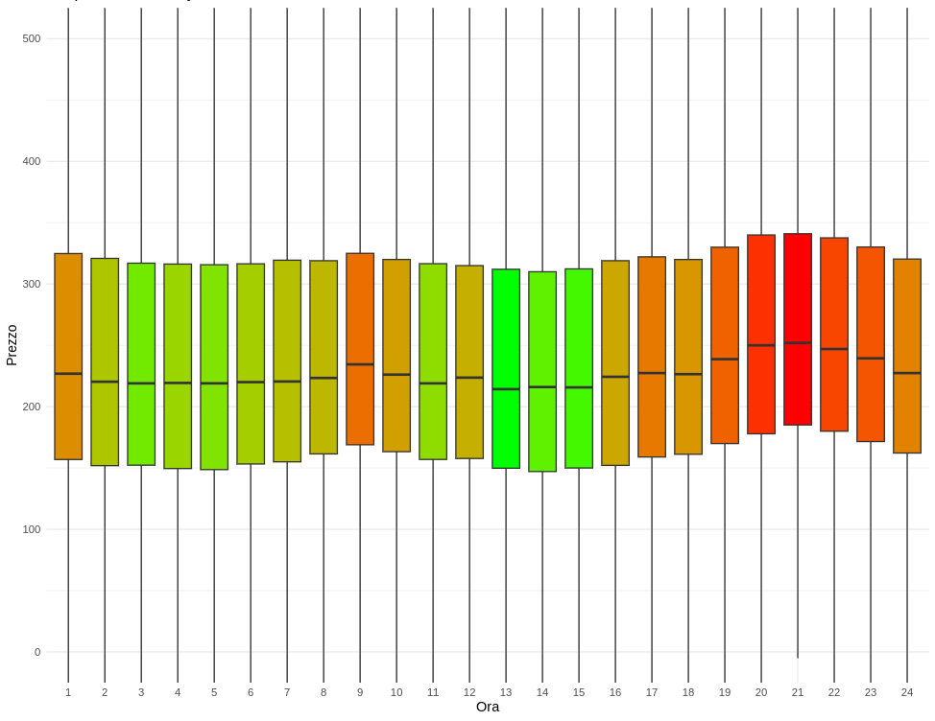
Hourly Price Trend Insight
January 22
January 23
June 22
June 23

Slide 6
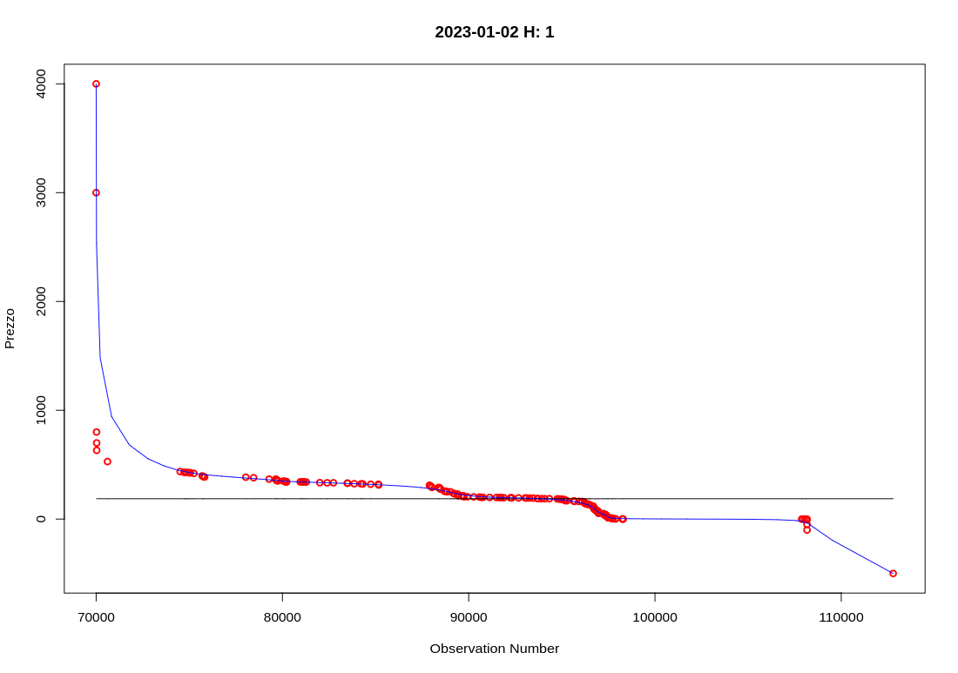
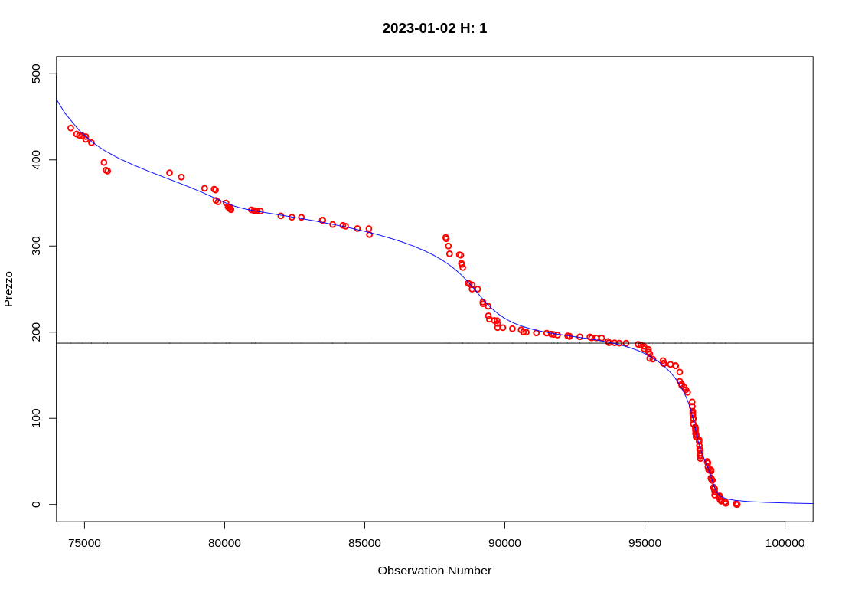
Smoothing – work in progress
Zoom in
Zoom out

Slide 7
